Slide 1

DRIVER’S FATIGUE LEVEL DETECTION
SYED SALMAN HAIDER
HIBA HAIDER
FATIMA ZAIN
SUPERVISOR: SAMI UL AHBAB

Slide 2
INTRODUCTION
Road accidents are suspected to be a primary concern nowadays and the key cause is the fatigue level of the driver which is a subject of intense research today.
Our project emphases on building a facial recognition system for driver sleepiness which can be due to long hours, shift work, lack of sleep or sleep apnoea that may exhaust the driver and cause him/her to sleep while driving

Slide 3
The Problem
Driver’s fatigue is a serious problem nowadays which results in many road accidents each year.
It was discovered that Road traffic crashes in Pakistan result in mostly accidents on motorway (54%) and serious injuries on N-5 highway(41%).
It has been assessed that about 90 percent accidents in Pakistan occur due to the mistake of drivers

Slide 4
OUR SOLUTION
Real time camera monitoring
Rings an alarm if driver is found sleepy!
Sprinkle water to ensure driver is up
Our system will have a night vision camera to ensure that our system works at night as well.

Slide 5
Hardware and Software
Hardware:
Camera
Raspberry PI
Alarm buzzer
Software:
Python
OpenCV

Slide 6
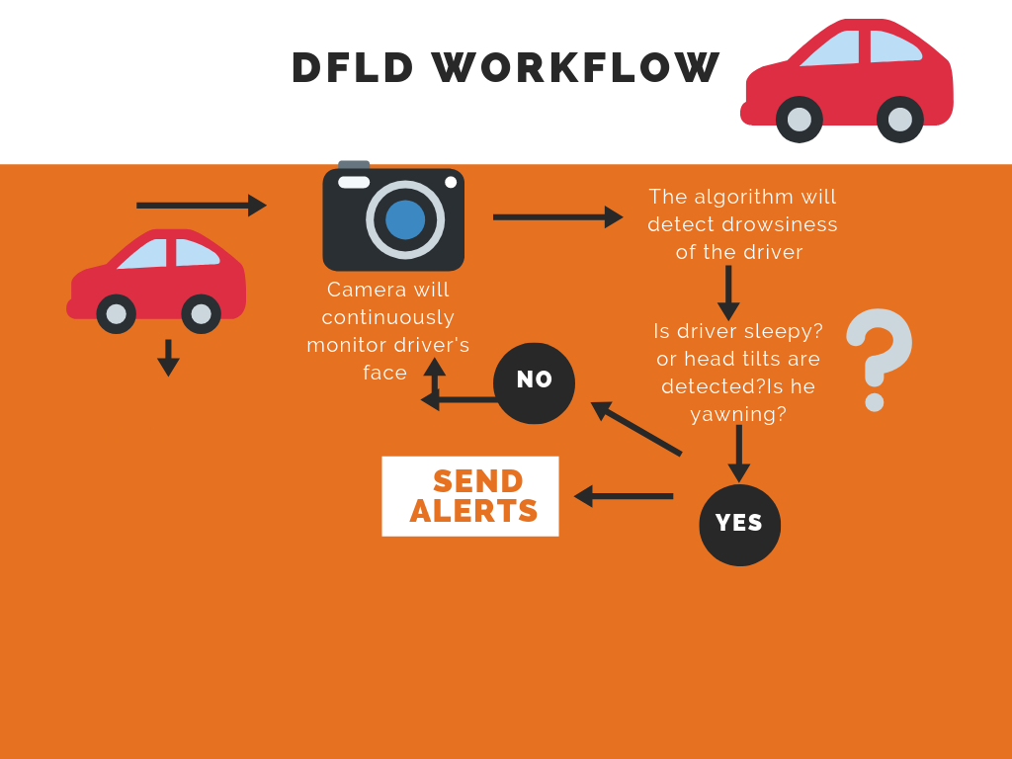
WORKFLOW :

Slide 7
Main Algorithms :
1) HOG+ Linear SVM : Histogram of oriented gradients and linear support vector machines can be used in conjunction as a classifier to detect face and extract eye region from an image.
2) Haar cascade : A machine learning algorithm to identify the objects in images.

Slide 8
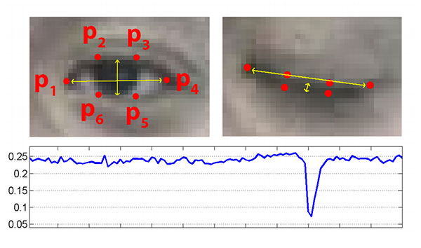
Later EAR (eye aspect ratio) will be calculated after applying classifiers.
EAR =||p2-p6 ||+ ||p3-p5 || / 2||p1-p4 ||
If EAR is less than threshold then alerts will be send accordingly

Slide 9
MAIN ADVANTAGES :
Warns the driver of drowsiness and the risk of sleep
Compliance with driver warnings helps to avoid road accidents caused by fatigue
Will keep drivers attentive
It not just uses an alarm but water spray as well to alert the driver.
Uses night vision camera so that the system works at night as well.

Slide 10
ANY QUESTIONS?

